Slide 1

DATS 6103 Introduction to Data Mining Individual Project III Topic: FIFA players’ Value analysis
G48606690
HungChun Lin
Instructor: Nima Zahadat

Slide 2

Information
Dataset (.csv files) came from Kaggle:
FIFA 19 complete player dataset:
https://www.kaggle.com/karangadiya/fifa19
FIFA World Cup:
https://www.kaggle.com/abecklas/fifa-world-cup
https://www.goal.com/en/news/best-fifa-19-players-global-series-ranks-best-pro-esports/9njxq7lmpzmb1nmckdswjhghq

Slide 3

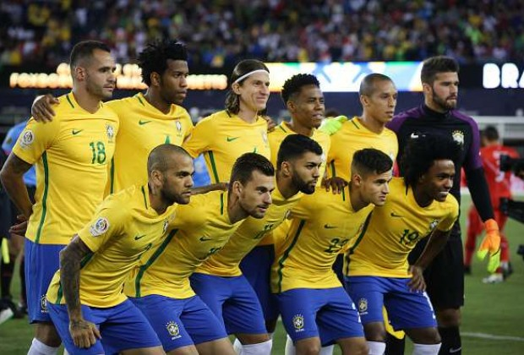
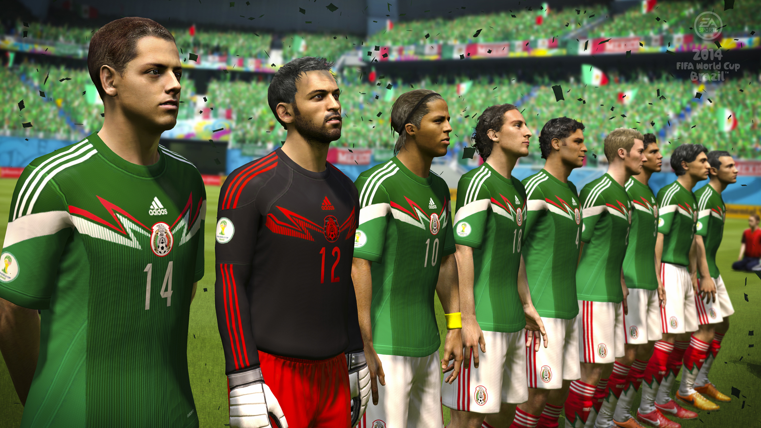
Overview
World Cup
Vedio Game
Wage
Position
Value
Country
Skill
Body
https://www.cnn.com/2019/03/19/tech/stadia-google-gaming/index.html
https://www.gamesradar.com/2014-fifa-world-cup-brazil-review/
https://www.telegraph.co.uk/world-cup/2017/11/09/fifa-world-cup-2018-ball-unveiled-adidas/
https://www.soccerladuma.co.za/news/articles/international/categories/world-cup-2018/12-stars-snubbed-for-brazil-s-2018-fifa-world-cup-squad/295003?page=9

Slide 4
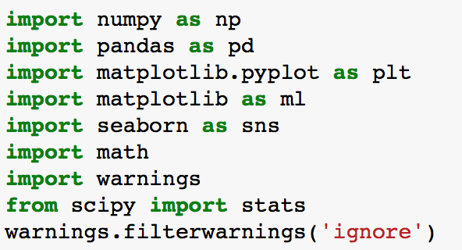
Packages for this project

Slide 5
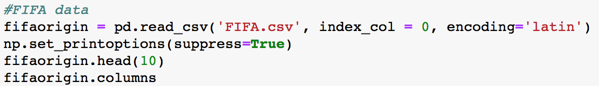
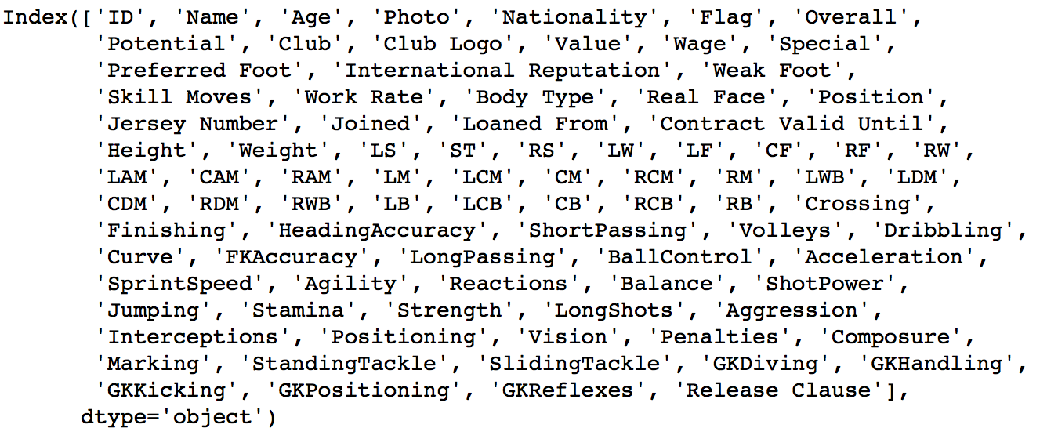
Data cleaning & processing
Read the csv. file
Check the index in the original file (For selection)

Slide 6
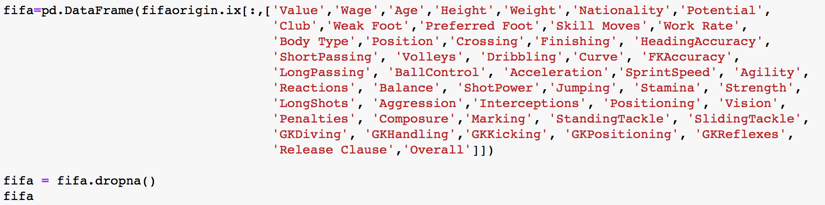
Data cleaning & processing
3) Select the index we want

Slide 7
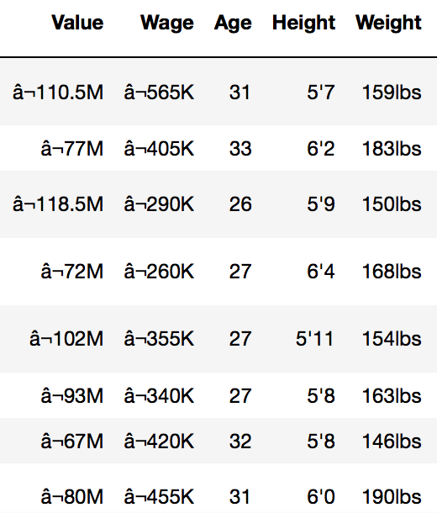
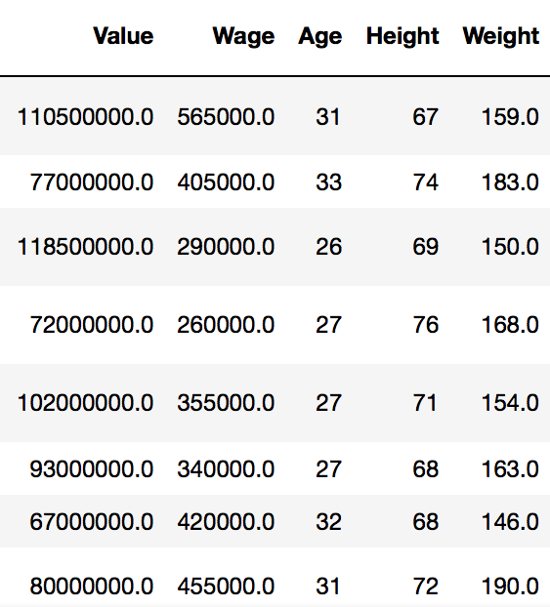
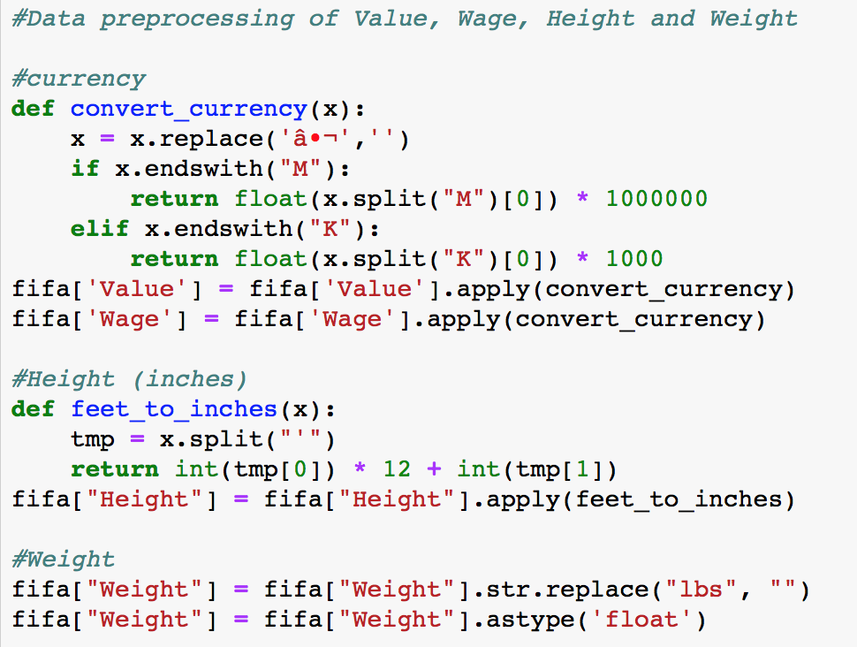
Data cleaning & processing
4) Convert the value (Value/Wage/Height/Weight) to float
Original
Converted

Slide 8
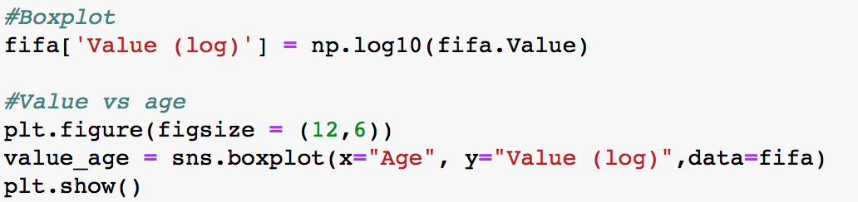
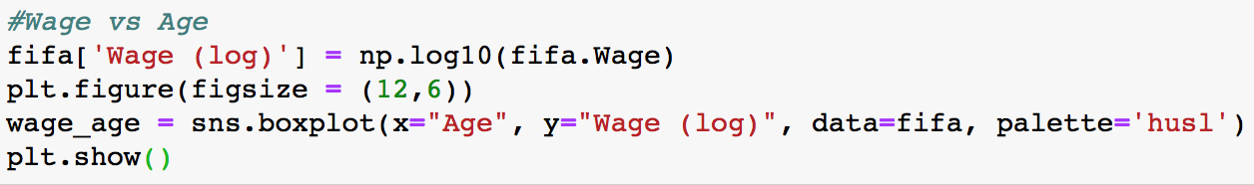
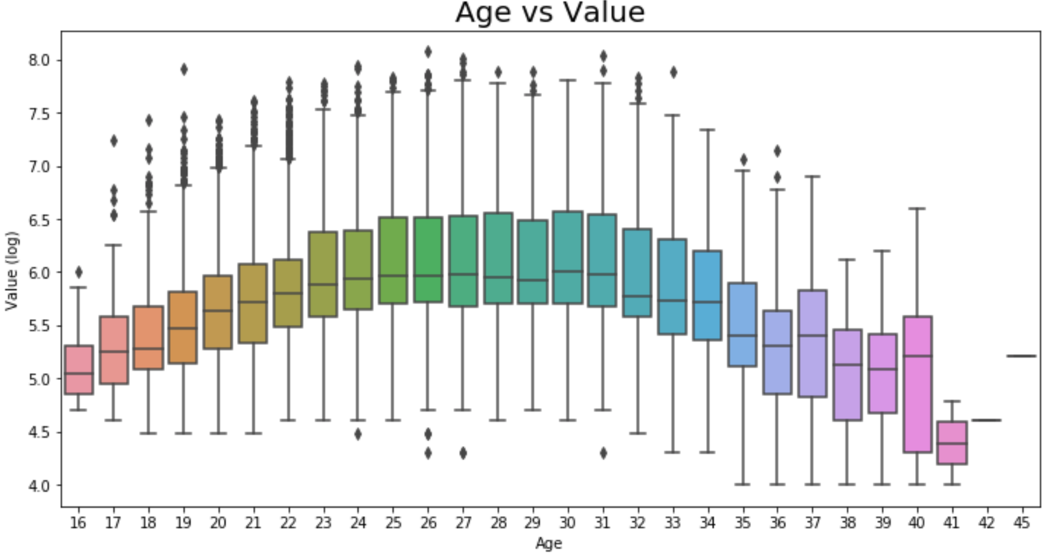
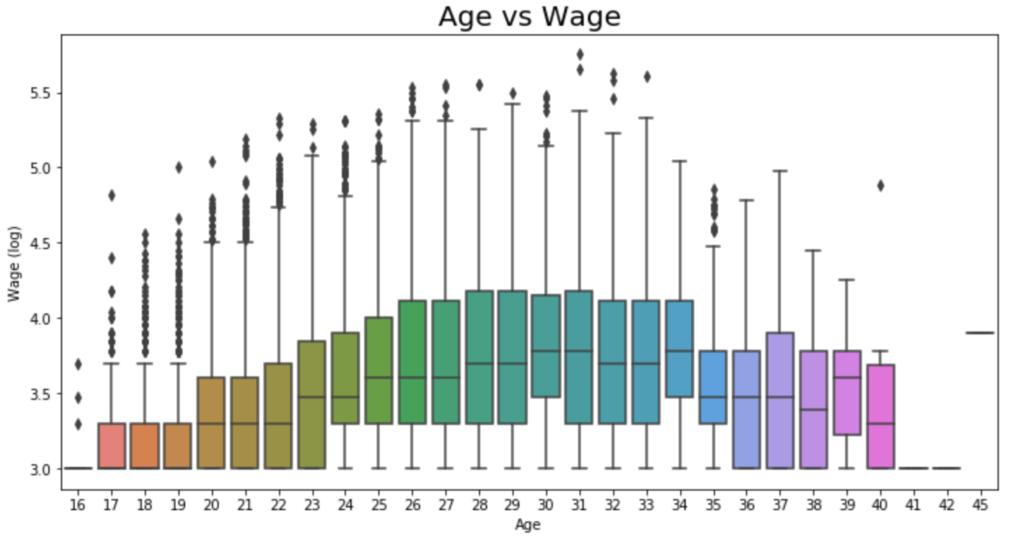
Demographic factors
Sweet-spot age:
25 - 31
Sweet-spot age:
28 - 34

Slide 9
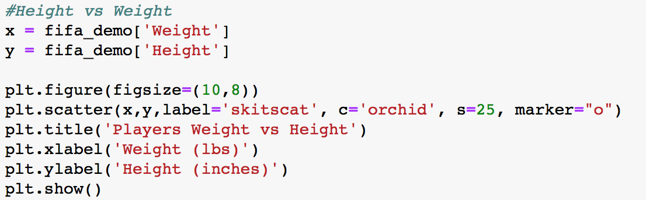
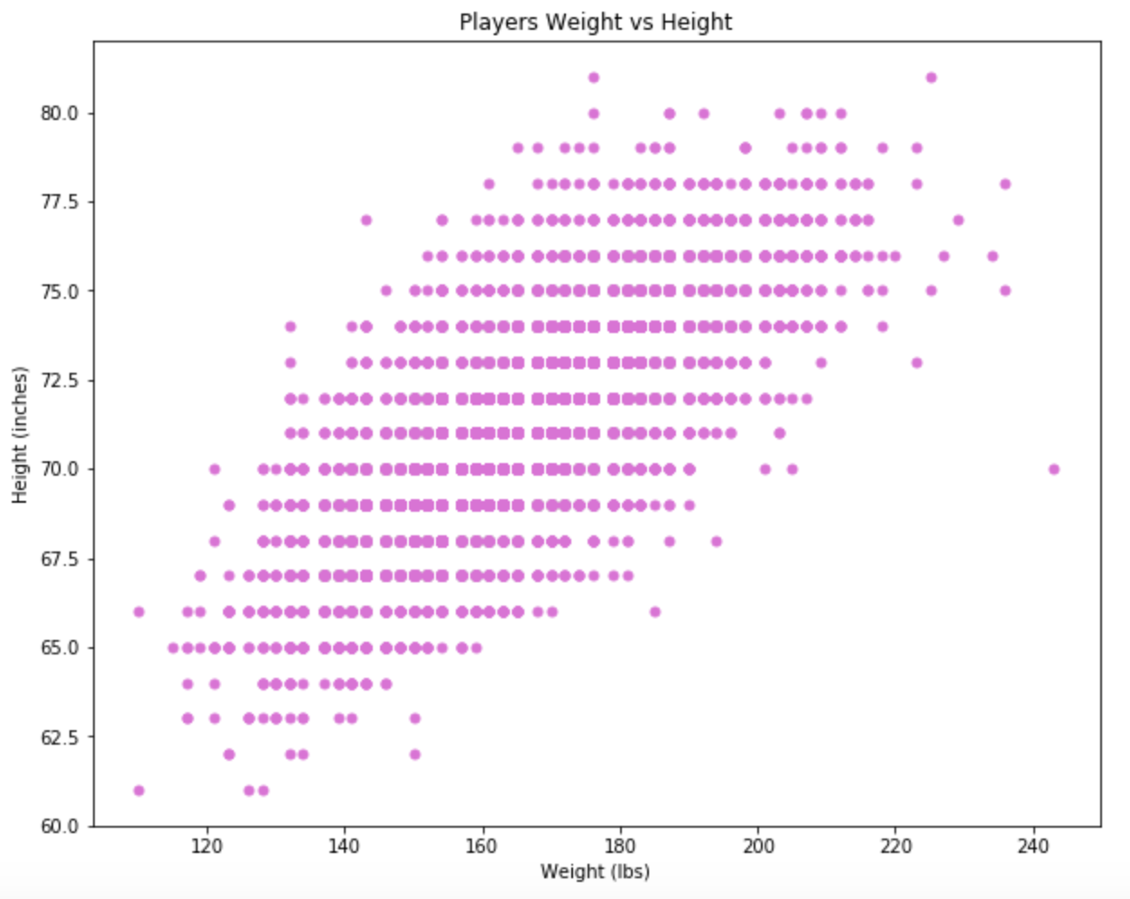
Demographic factors
Weight and Height has strong correlation

Slide 10
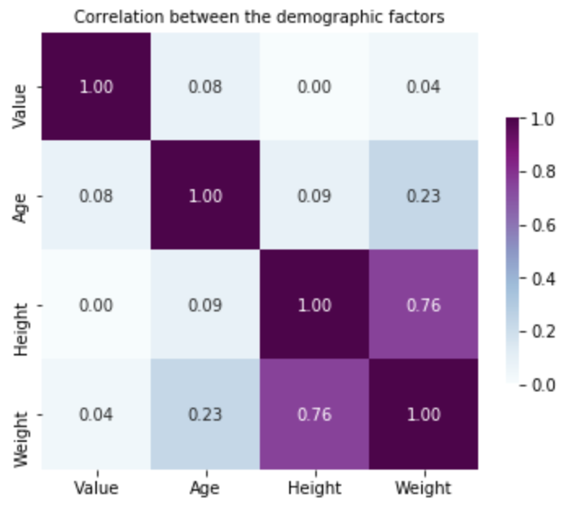
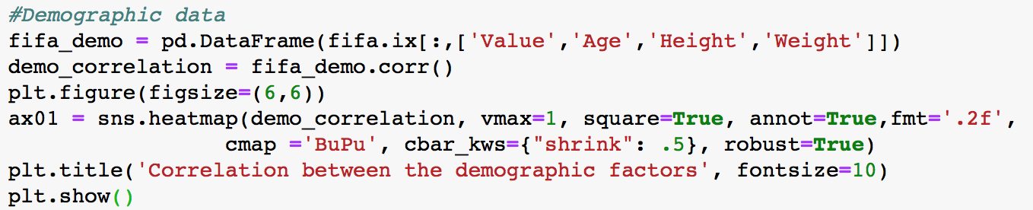
Correlation of demographic factors
No strong correlation between demographic factors and value

Slide 11
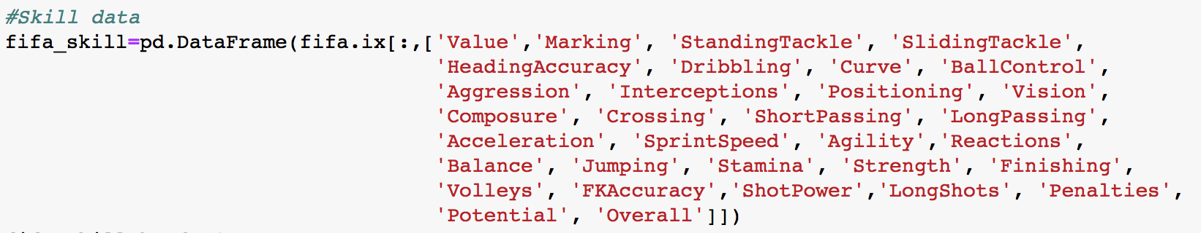
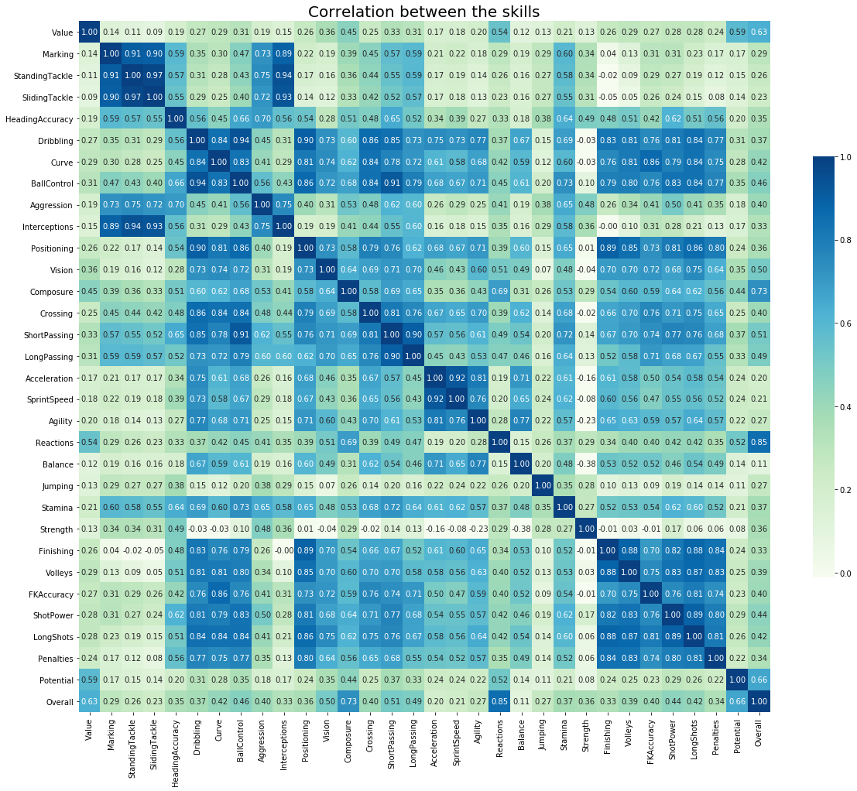
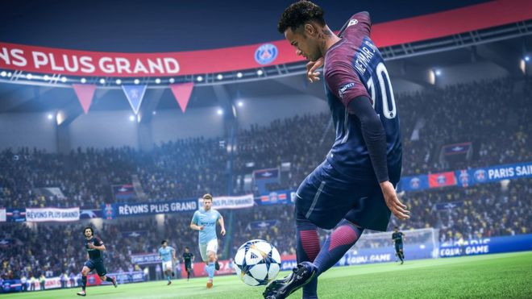
Skill factors
https://www.bbc.com/news/newsbeat-45642620

Slide 12
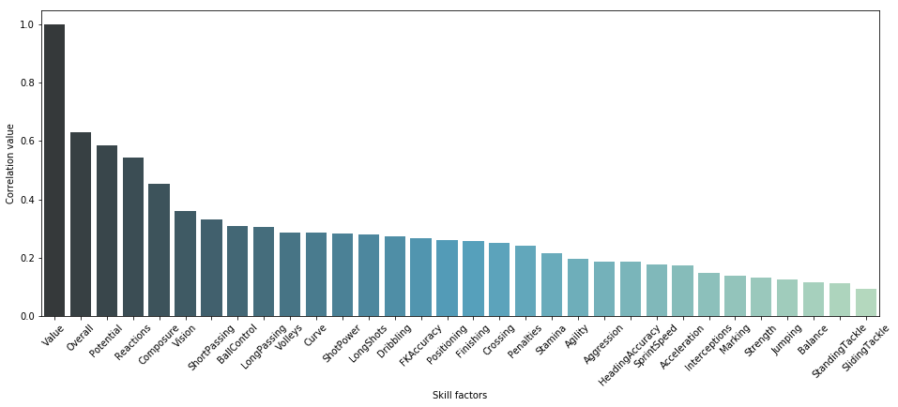

Slide 13
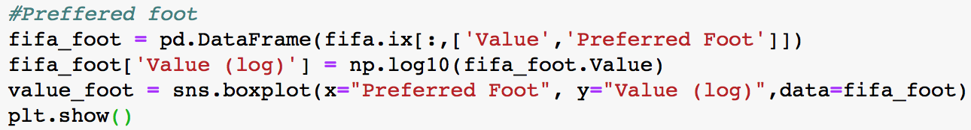
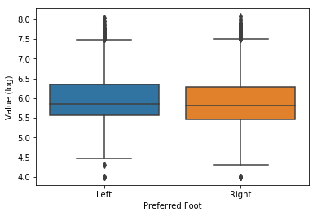
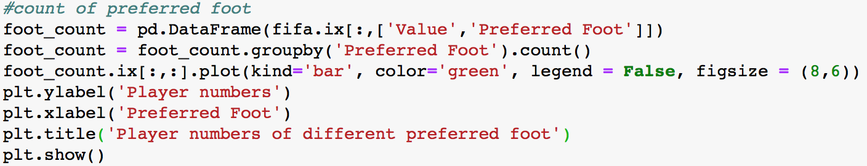
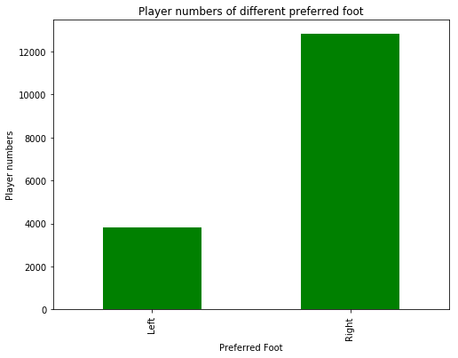
Preferred Foot
Preferred Foot does not affect Value much

Slide 14
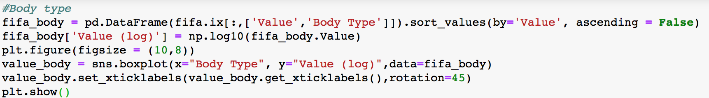
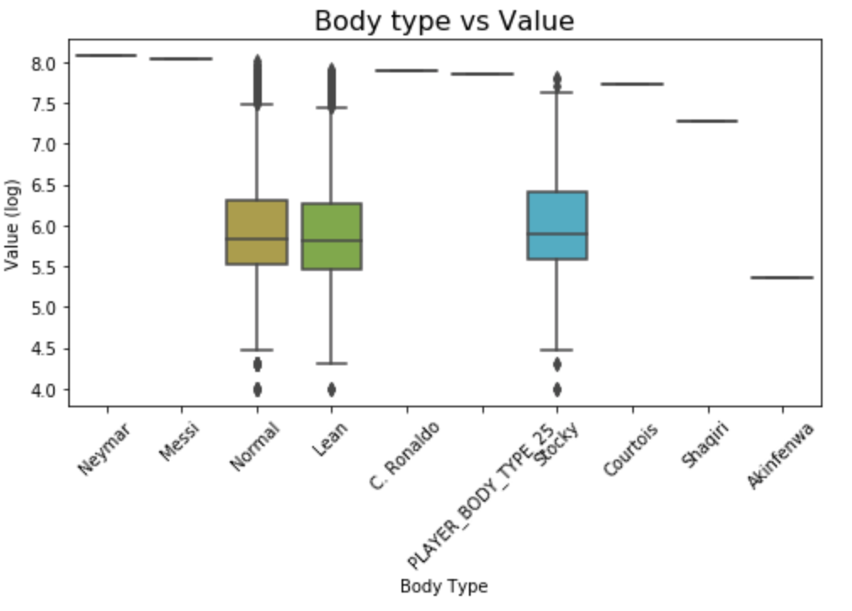
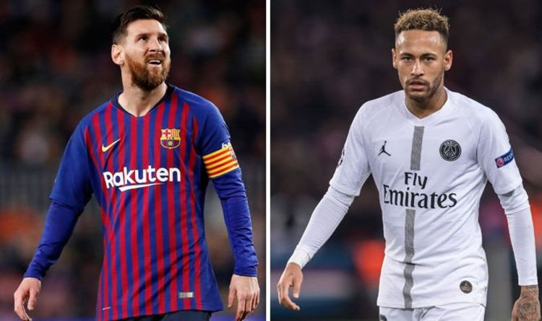
Body type
https://www.express.co.uk/sport/football/1055021/Lionel-Messi-Neymar-Cristiano-Ronaldo-Barcelona-Ballon-dOr

Slide 15
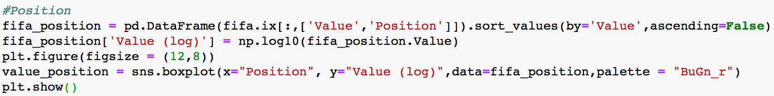
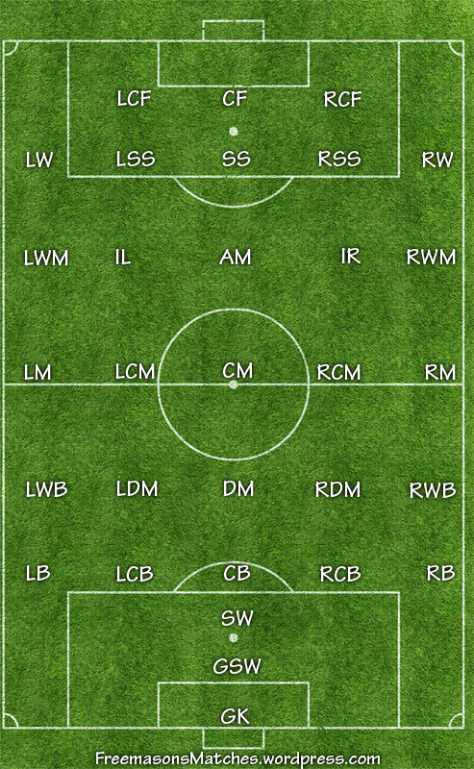
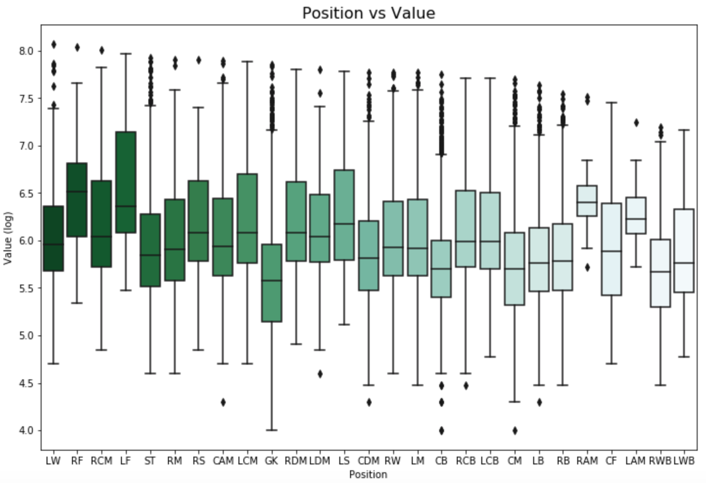


Position

Slide 16
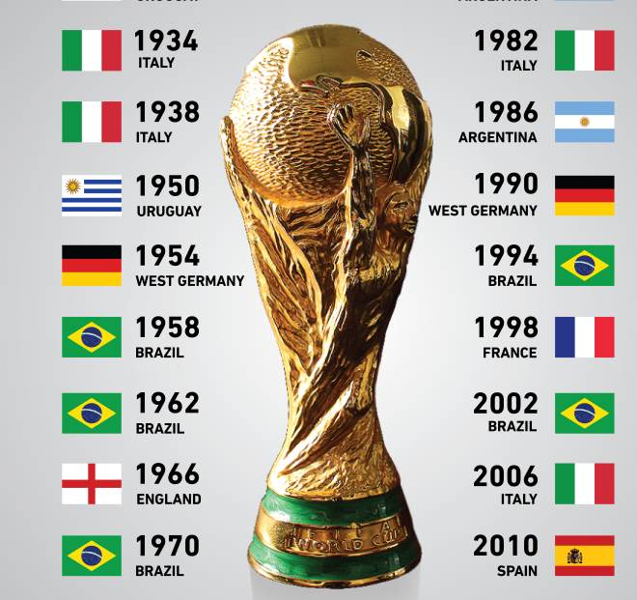
World cup rewards
1930 - 2014

Slide 17
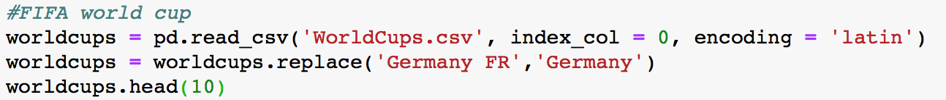
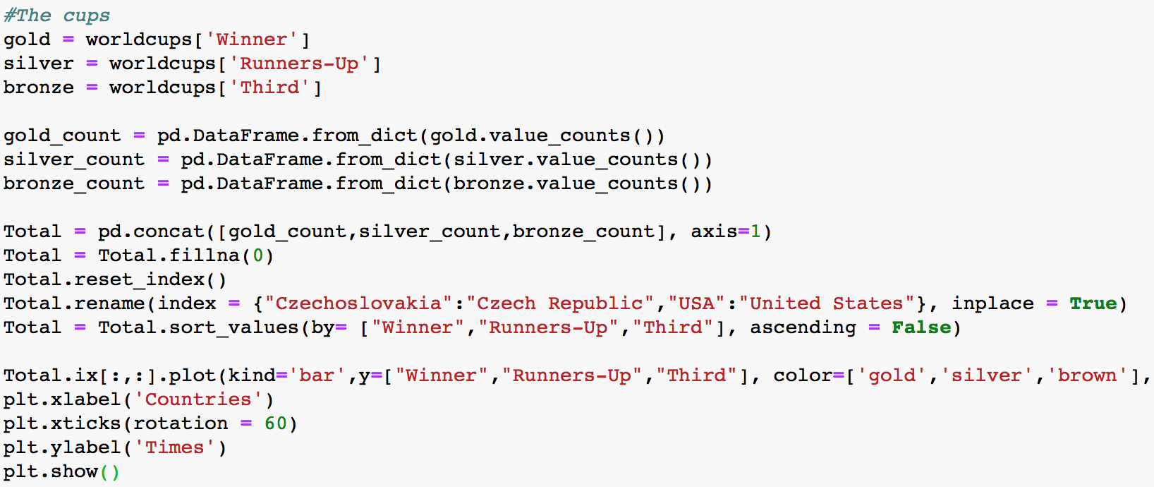
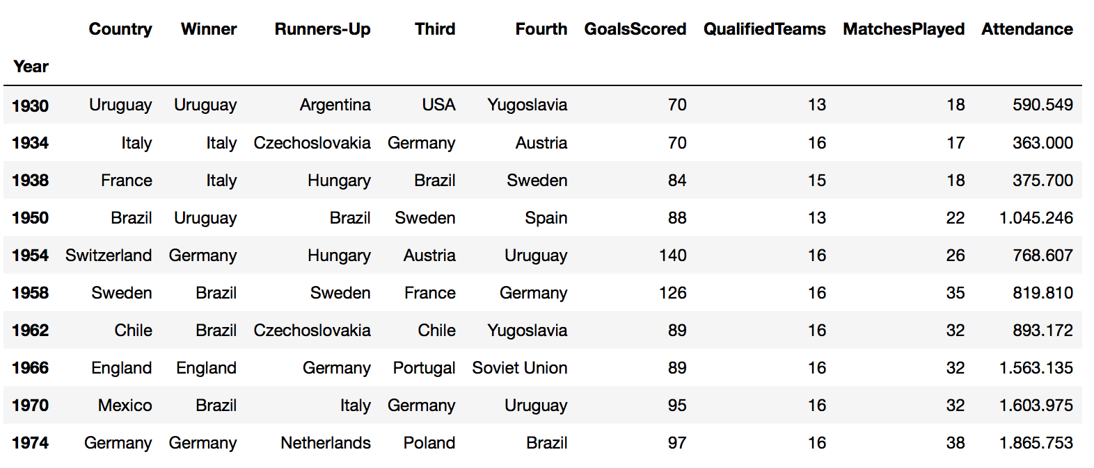
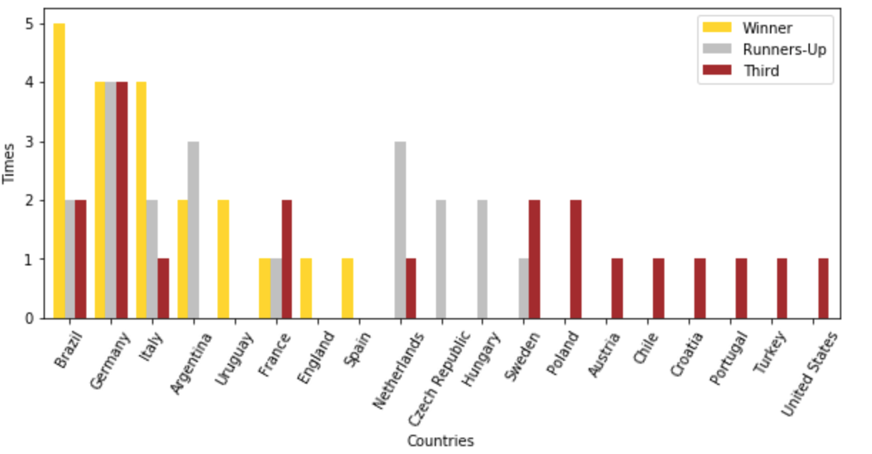
World cup rewards 1930 - 2014
Rank | Country
1 | Brazil
2 | Germany
3 | Italy
4 | Argentina
5 | Uruguay
6 | France
7 | England
8 | Spain
9 | Netherlands
10 | Czech Republic

Slide 18
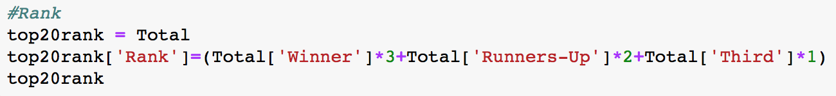
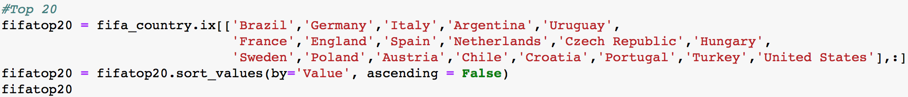
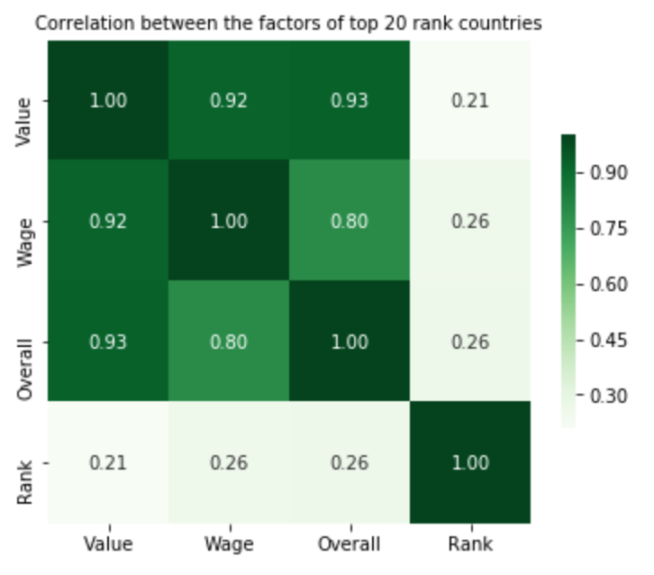
World cup rewards 1930 – 2014:
Countries that have won awards
 | Winner | Runners-Up | Third | Rank
Germany | 4.0 | 4.0 | 4.0 | 24.0
Brazil | 5.0 | 2.0 | 2.0 | 21.0
Italy | 4.0 | 2.0 | 1.0 | 17.0
Argentina | 2.0 | 3.0 | 0.0 | 12.0
France | 1.0 | 1.0 | 2.0 | 7.0
Netherlands | 0.0 | 3.0 | 1.0 | 7.0
Uruguay | 2.0 | 0.0 | 0.0 | 6.0
Sweden | 0.0 | 1.0 | 2.0 | 4.0
Hungary | 0.0 | 2.0 | 0.0 | 4.0
Czech Republic | 0.0 | 2.0 | 0.0 | 4.0
Spain | 1.0 | 0.0 | 0.0 | 3.0
England | 1.0 | 0.0 | 0.0 | 3.0
Poland | 0.0 | 0.0 | 2.0 | 2.0
Austria | 0.0 | 0.0 | 1.0 | 1.0
Chile | 0.0 | 0.0 | 1.0 | 1.0
Croatia | 0.0 | 0.0 | 1.0 | 1.0
Portugal | 0.0 | 0.0 | 1.0 | 1.0
Turkey | 0.0 | 0.0 | 1.0 | 1.0
United States | 0.0 | 0.0 | 1.0 | 1.0

Slide 19
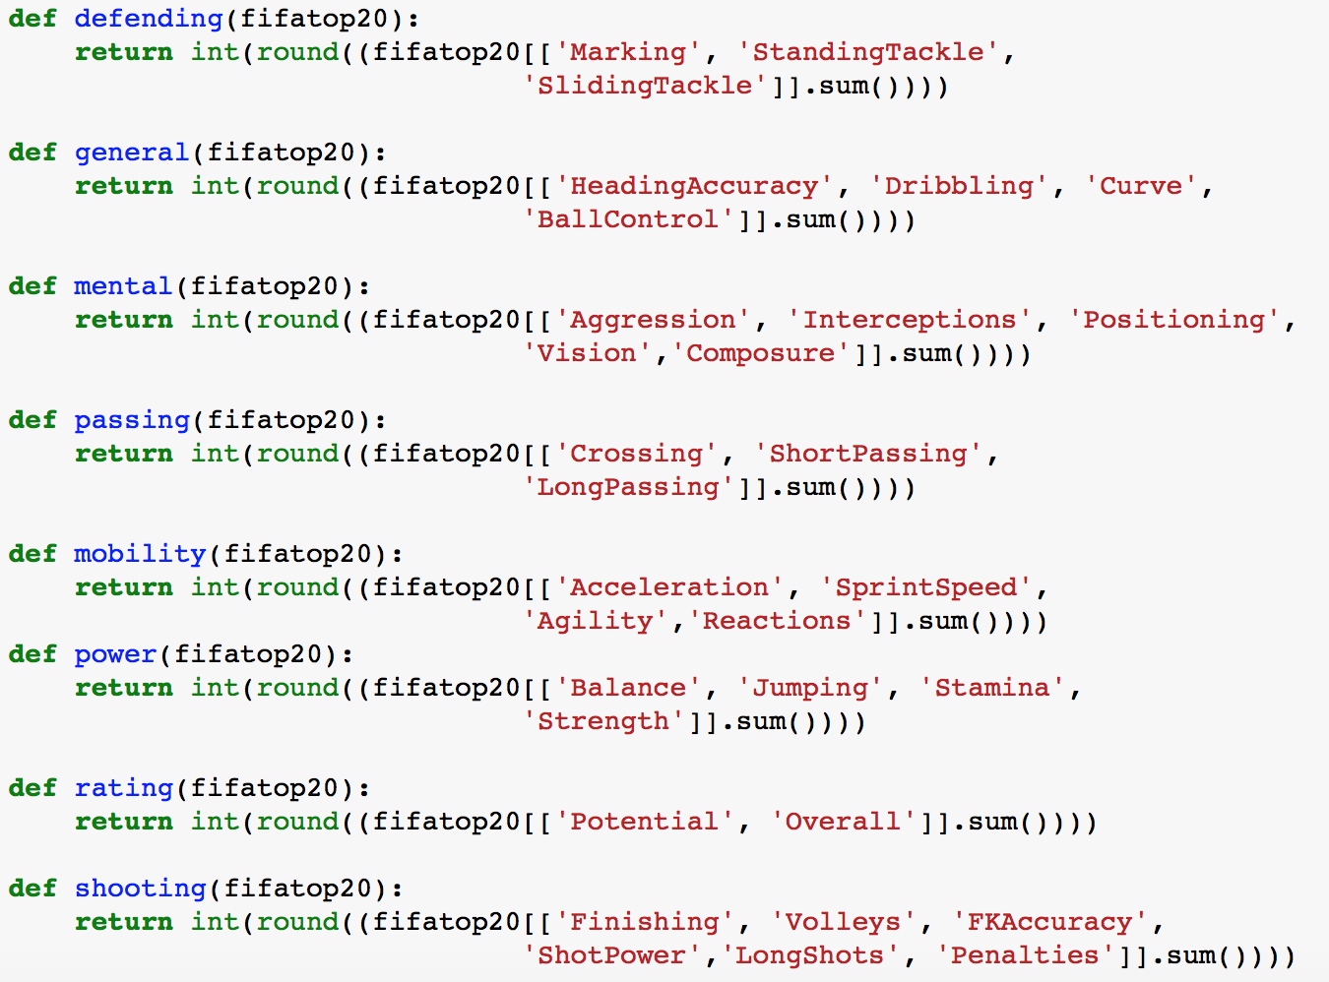
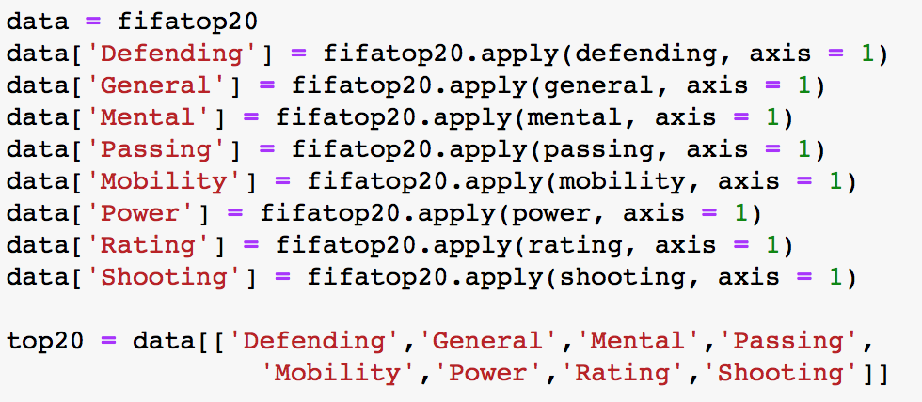
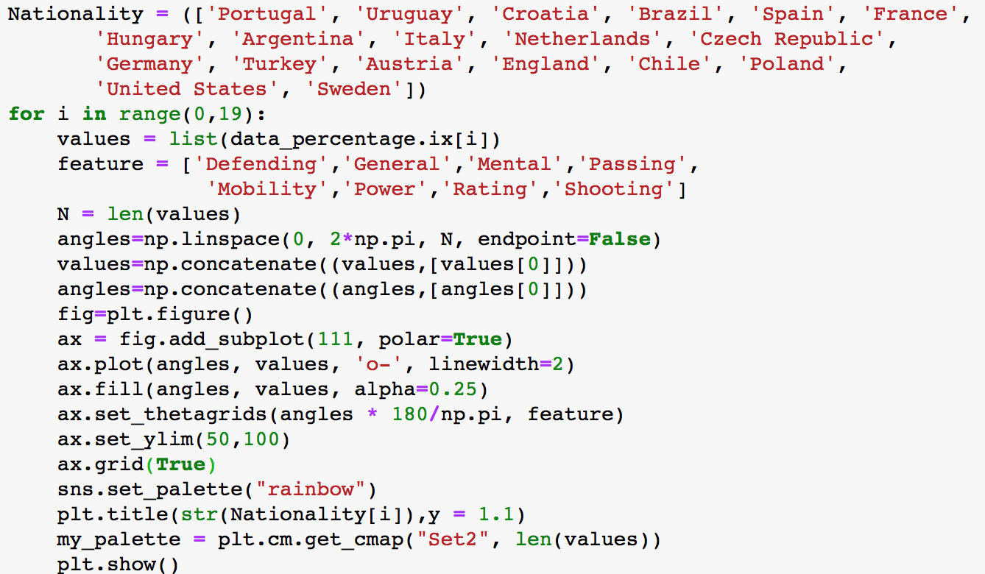
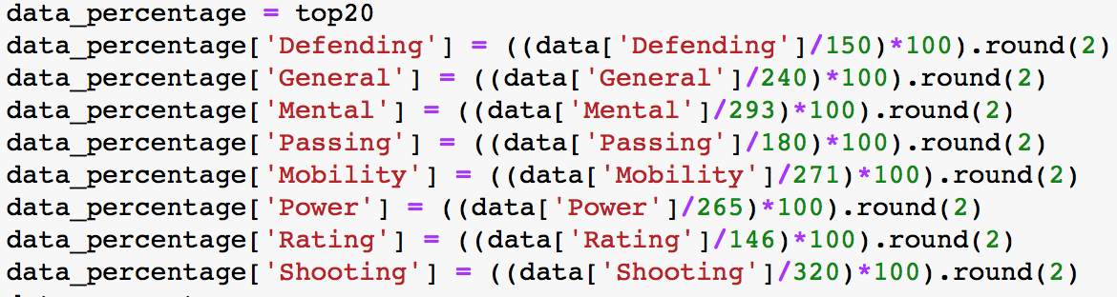
1. Defining skill
2. Create a new Dataframe
3. Got points of each items
4. Draw radar plots

Slide 20
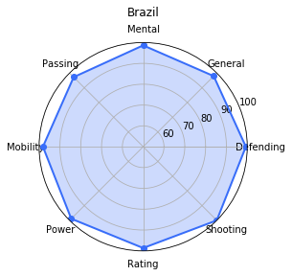
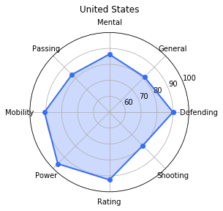
Capacity distribution of different countries
Capacity | Skills
Mental | Aggression Interceptions Positioning | Vision Composure
General | Heading Accuracy Dribbling | Curve Ball Control
Defending | Marking Standing Tackle Sliding Tackle
Shooting | Finishing Volleys FK Accuracy | Shot Power Long Shots Penalties
Rating | Potential Overall
Power | Balance Jumping | Stamina Strength
Mobility | Acceleration Sprint Speed | Agility Reactions
Passing | Crossing Short Passing Long Passing
Rank 1
Rank 19

Slide 21
Conclusion
1. The demographic factors do not effect the players’ value much.
2. The peak of a player’s wage is 3 years later than the peak of value.
3. The reactions in the skill factors is the most influential factors to a player’s value.
4. The right foot preferred players are much more than left foot preferred, but the values do not have big differences.
5. The country which has the higher rank does have the higher point at each capacity.

Slide 22
Reference
https://stackoverflow.com/
https://matplotlib.org/index.html#
https://pandas.pydata.org/pandas-docs/stable/
https://www.kaggle.com/
https://www.fifa.com/the-best-fifa-football-awards/news/the-best-fifa-football-awardstm-to-introduce-two-new-women-s-football-honours

Slide 23

Thanks

Slide 24



